Slide 1
Agentic AI for Personalized Course Pathways
IBM AGENTIC_AI PROJECT
Presented By:
Student name : Animesh Bhakat
College Name & Department : Chaibasa Engineering College Electronics & Communication Engineering

Slide 2
OUTLINE
Problem Statement
Technology used
IBM Cloud Service Used
WOW Factor
End Users
Results
Conclusion
Future scope
IBM Certifications
GitHub Link

Slide 3
Problem Statement
Students often struggle to identify the right learning path that aligns with their interests and long-term goals due to the overwhelming number of online courses and a lack of personalized guidance. LearnMate aims to solve this by acting as an Agentic AI coach that interacts with students, understands their interests (like Frontend Development, Cybersecurity, UI/UX Design, etc.), assesses their current skill level, and dynamically builds a personalized course roadmap that adapts over time based on progress and preferences.
Proposed Solution: An intelligent agentic AI-powered system designed to guide students in discovering, validating, and achieving their learning and career aspirations. It tackles the overload of online course options and lack of personalized direction by offering a continuously evolving, student-centric coaching experience.

Slide 4
Technology used
IBM cloud lite services
Natural Language Processing (NLP)
IBM Granite model

Slide 5
IBM cloud services used
IBM Cloud Watsonx AI Studio
IBM Cloud Watsonx AI runtime
IBM Cloud Agent Lab
IBM Granite foundation model

Slide 6
Wow factors
Conversational, Adaptive Mentorship – Feels like chatting with a mentor who learns about you in real-time and evolves alongside your journey.
Live Labor Market Sync – Recommends courses based on trending skills and job roles backed by up-to-date market intelligence.
Dynamic Learning Roadmaps – Your path updates automatically based on progress, feedback, and changing interests—no manual reshuffling.
Scenario-Based Skill Validation – Students complete challenges tied to real-world tasks, giving LearnMate deeper insight into actual capabilities.
Gamified Career Exploration – Unlock badges, preview future roles, and build momentum with immersive, milestone-driven experiences.
Micro-Persona Recognition - Learns how each student thinks, works, and learns—whether they’re visual, logical, fast-trackers, or slow burners.

Slide 7
End users
High School & College Students
Career Switchers
Online Learners & Self-Starters
Vocational & Technical Learners
EdTech Institutions & Learning Platforms

Slide 8
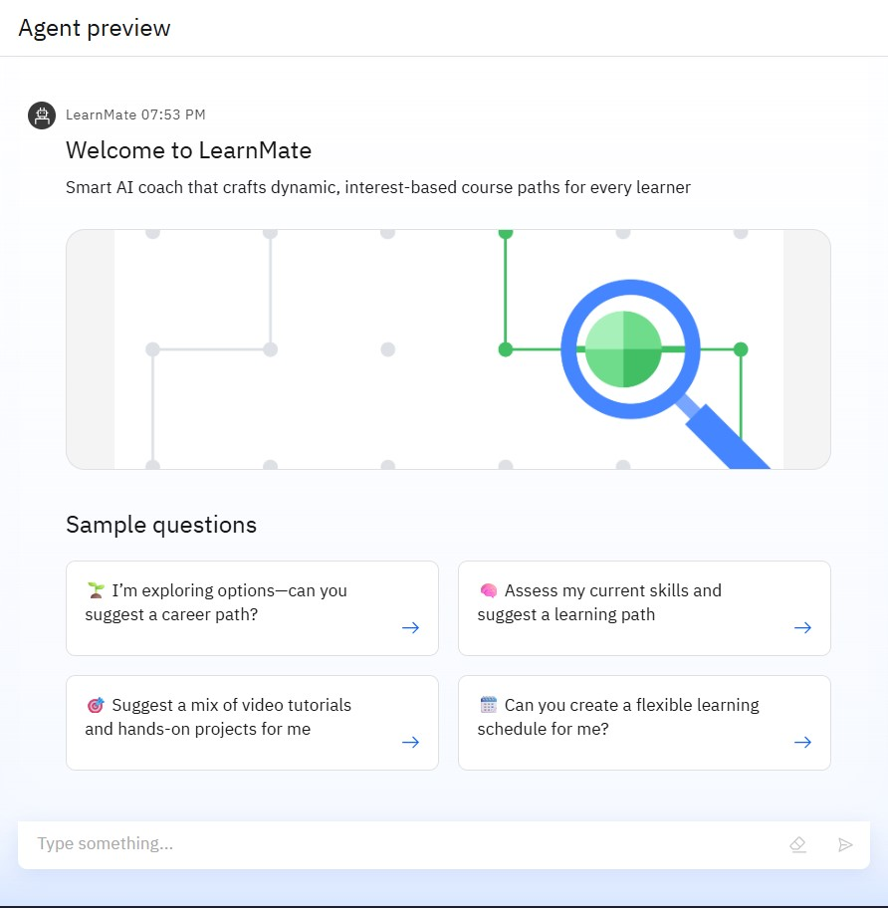
Results

Slide 9
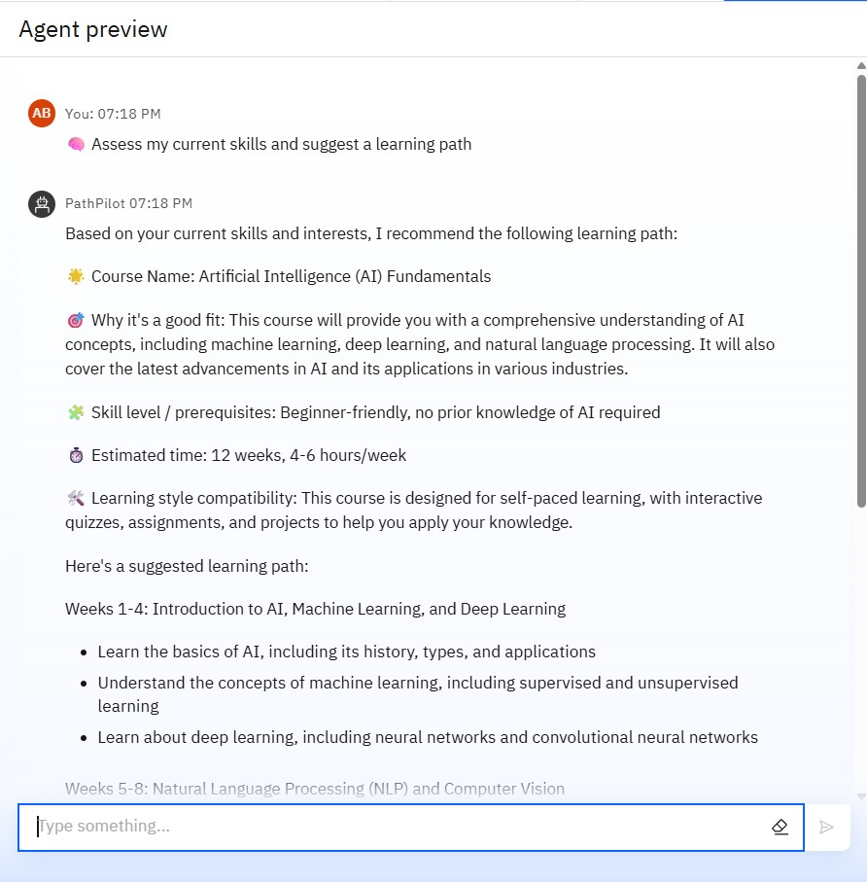
Results

Slide 10
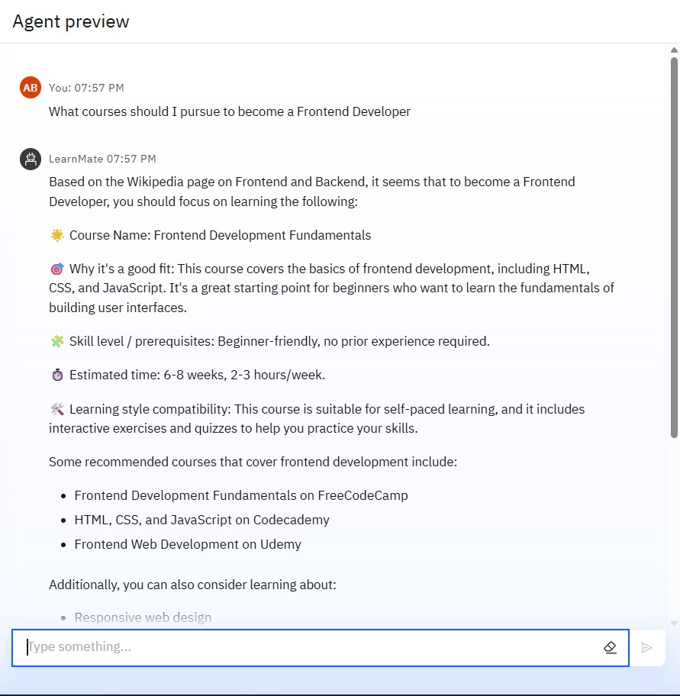
Results

Slide 11
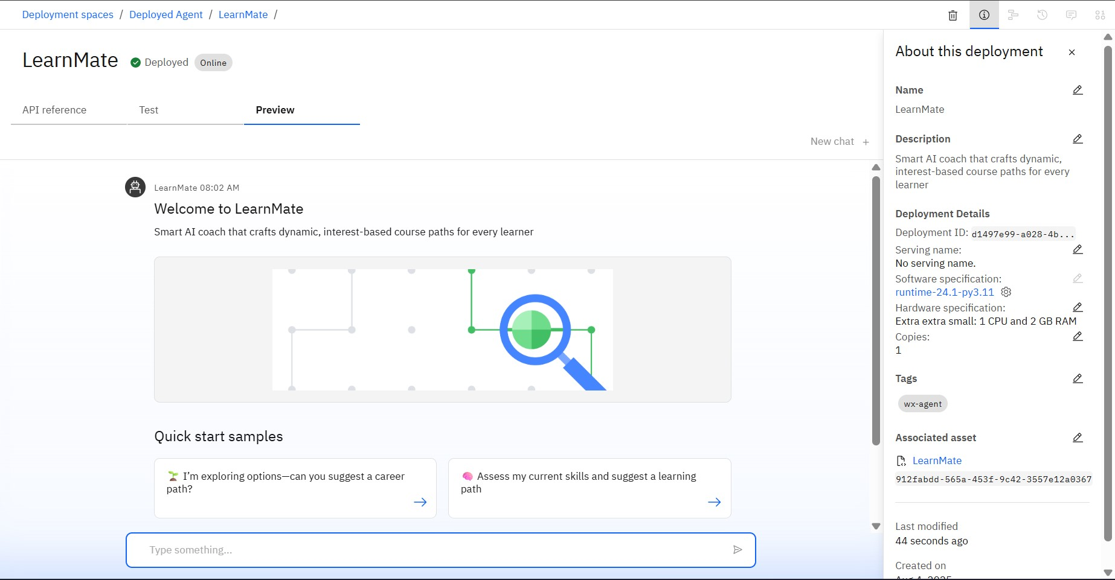
Results
Deployed AI Agent

Slide 12
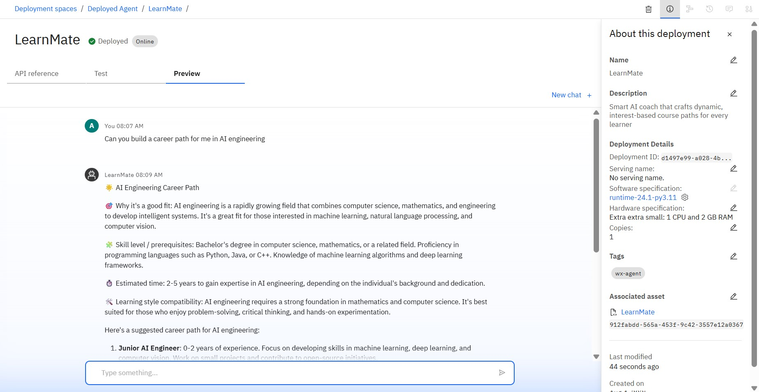
Results
Deployed AI Agent

Slide 13
Conclusion
LearnMate addresses a critical gap in student guidance by combining intelligent agentic AI systems with real-time adaptation and labour market relevance. It transforms fragmented learning into a meaningful, personalized journey—boosting motivation, clarity, and future readiness. By simulating mentorship, validating skills through real-world challenges, and adapting to evolving user interests, LearnMate becomes more than just a course recommender—it’s a lifelong learning coach.

Slide 14
Future scope
Multi-Platform Expansion: Integrate with mobile apps, learning management systems (LMS), and messaging platforms for seamless on-the-go guidance.
Peer-Led Learning Pods: Enable group-based mentorship, peer validation, and collaborative challenges, fostering a community-driven model.
Global Skills Mapping: Tailor learning paths to regional job markets by localizing industry demands, certifications, and language preferences.
Institution Integration: Offer analytics-driven dashboards to schools, colleges, and EdTech platforms to optimize curriculum and learner support.
AI-Agent Personality Customization: Let users choose coaching personas (e.g., motivational, analytical, friendly) to enhance emotional engagement and retention.

Slide 15
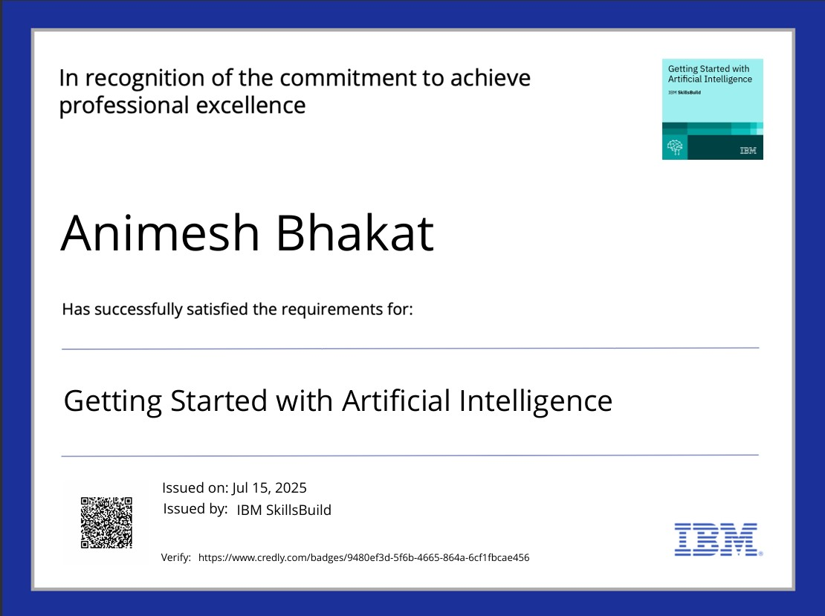
IBM Certifications

Slide 16
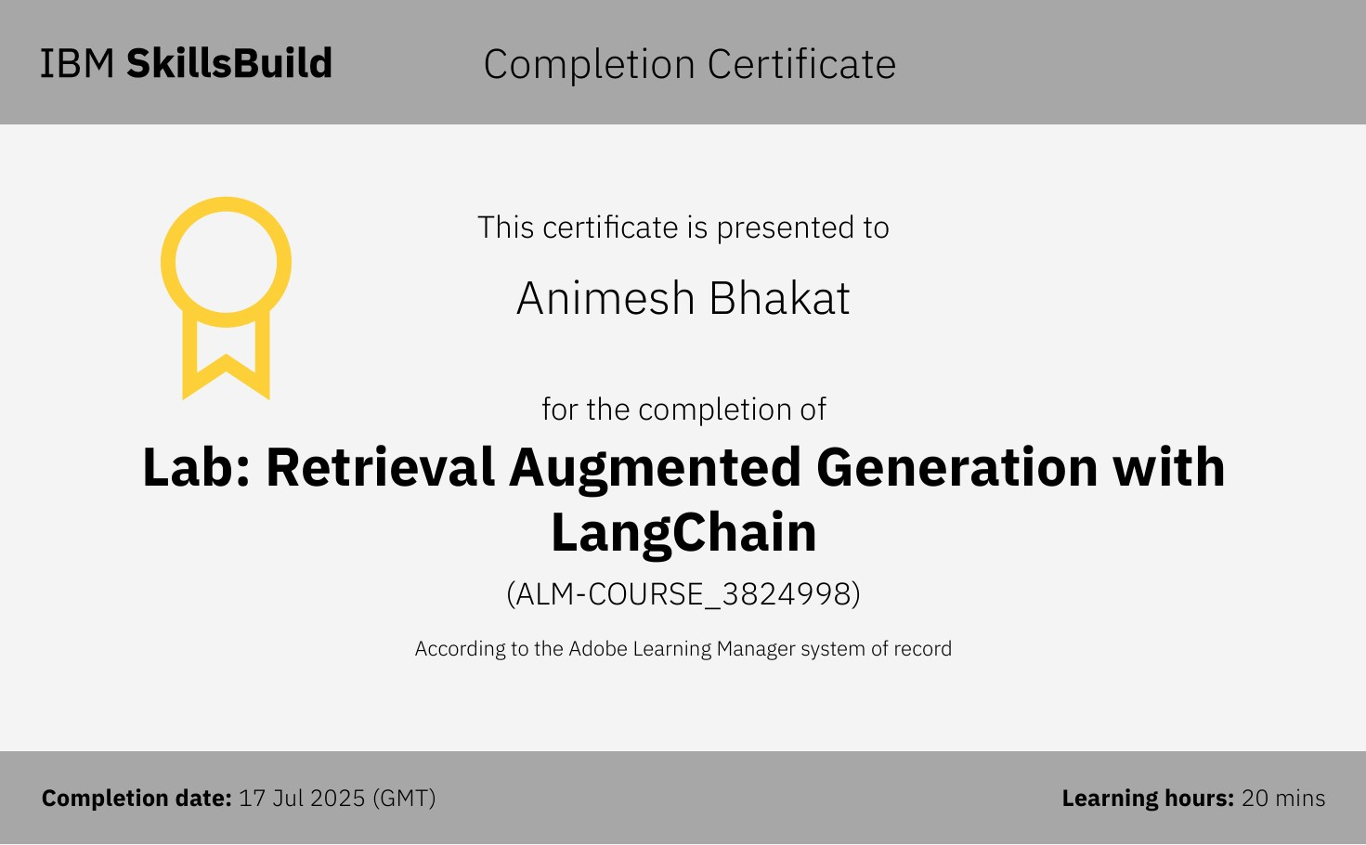
IBM Certifications

Slide 17
GitHub Link
GitHub Project Link :- Ani465/LearnMate-Agentic-AI

Slide 18
THANK YOU

